Slide 1
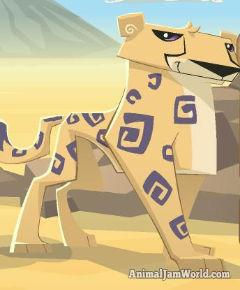

Slide 2
Animal jam gifts
Many Jammers know that every month, AJHQ sends a to special members of the Animal Jam Club as a thank you , because Club memberships help keep Animal Jam going and growing!

Slide 3
memberships
Animal Jam is free for everyone to play. All you have to do is choose a username and you can start exploring Jamaa. Non-members are able to have two different animals and some pets too. However there are some features in Animal Jam that are only available to members. Some of these features are listed below.
Have up to 24 different animals
Access to special members only animals
Weekly diamond giveaway to purchase rare items
Exclusive den items
Play members only games
Adopt any kind of pet
Use custom nametags and emotes
Early access to new games and areas
Much more

Slide 4
Animals
In animal jam there are lots of animals you can be such as hyena, arctic wolf, eagle, wolf, snow leopard, tiger, pander, fox, bunny, cheetah, kangaroo, lion, deer, seal, raccoon, penguin and more

Slide 5
THE END

